Slide 1
DEBUGGING JAVA PROGRAMS USING ECLIPSE DEBUGGER
SPECIAL JAVA SUBJECT FSOFT – Developer – Part3

Slide 2
Overview
What is a debugging
Debugging is the process of locating the source of programming errors (often called bugs) and correcting them
What is a debugger?
Set of tools that let us:
Pause a running program at any point
Examine the contents of the variables

Slide 3
Overview
Why a debugging?:
Debug our code (Why isn’t it working)
Get a better understanding of Java and OOP
Get familiar with a new program
Required debugging skills:
Understanding a break point
Stepping througth a program
Examining the contents of program variables

Slide 4
Overview
Basic debugging steps:
Switch to the Debug Perspective
Set one or more Breakpoint(s)
Run the Debugger (debug as program)
Step Over a Method Call.
Step Into a Method.
Step return
Inspecting Variables.
Debugging into Java Classes.
Review the Method Call Stack.

Slide 5
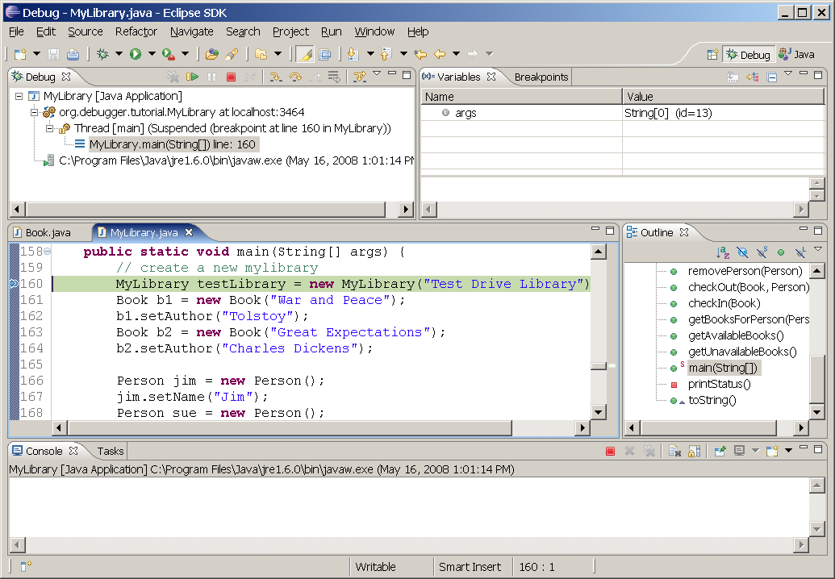
Eclipse Debugger
Debug Toolbar
Debug Perspective
Variable/Breakpoint view
Debug view (panel)
Java Perspective
Editor (source) view

Slide 6
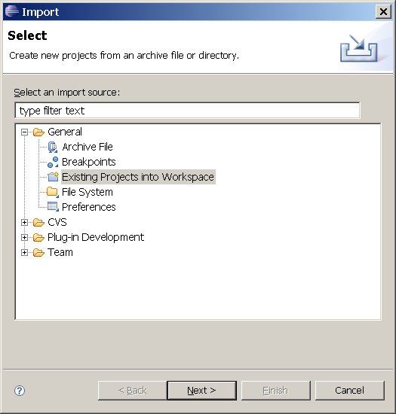
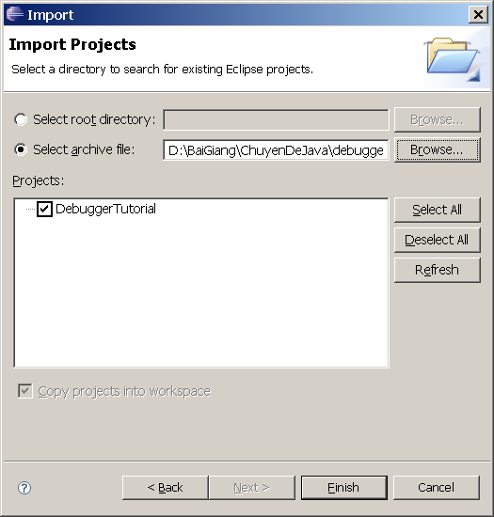
Load project from achive (.zip) file

Slide 7
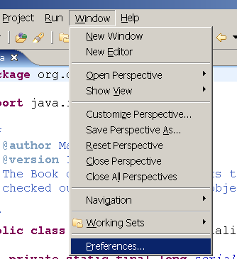
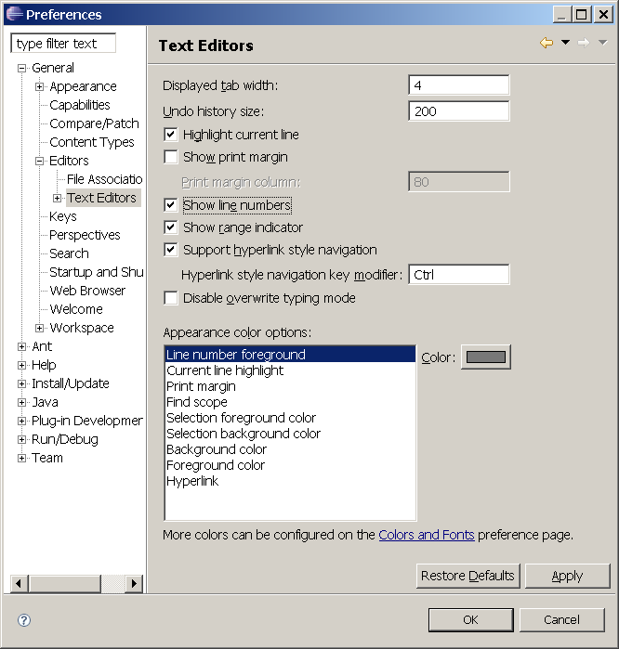
Show line numbers

Slide 8
Starting a debug session
Tell debugger where to pause
Set breakpoints
Run program in debug mode:
Run - Debug as … - Java Application

Slide 9
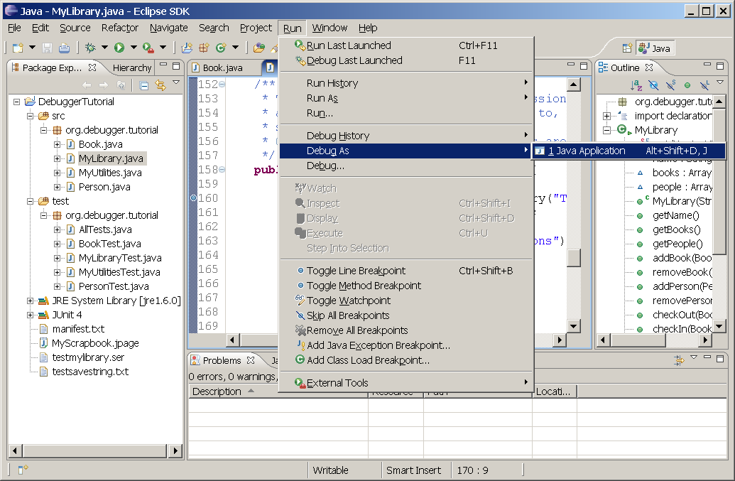
Starting a debug session
Breakpoint marker
Shaded area

Slide 10
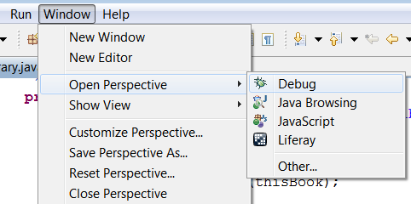
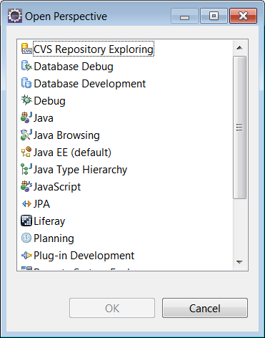
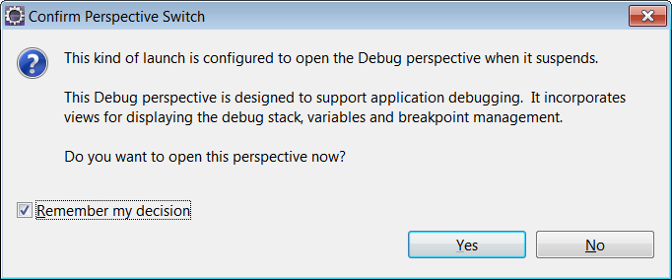
Switch to debug perspective

Slide 11
Eclipse Debug Perspective
Debug Toolbar
Debug Perspective
Variable/Breakpoint view
Debug view (panel)
Java Perspective
Editor (source) view

Slide 12
Debug ToolBar
Resume
Terminate
Step Over
Drop to Frame
Suspend
Step Into
Step Return
Step Filters
Resume : Execute the program until it ends, or until a breakpoint
Suspend: Pause an executing program; it is almost never used (except to stop an infinite loop).
Terminate: Terminate a debugging session;
Step Into: Move into the method (or constructor) and pause at the first line;
Step Over: Execute one Java statement (execute current line end stop at next line);
Step Return: Finish the current method and return to the calling method;
Drop to Frame: re-enter the current method from the top
Notes:
Drop to Frame: chạy lại từ đầu method (1 dòng trong stack view) đang debug

Slide 13
Part 1 – Basic
Switch to the Debug Perspective
Set one or more Breakpoint(s)
Run the Debugger (debug as program)
Step Over a Method Call.
Step Into a Method.
Step return
Review the Method Call Stack (FILO).
Example:
Class: MyLibrary, Method: main
Class: Book, Method: setAuthors

Slide 14
Part 2
Examine variable content
Resume Button
Run to Line (CTRL-L)
Expression view
Variable view
Display view
Console view
Watch -> Expression
Display (CTRL-SHIFT-D)
Inspect (CTRL-SHIFT-I)
Example:
Class: MyLibrary
Method: main

Slide 15
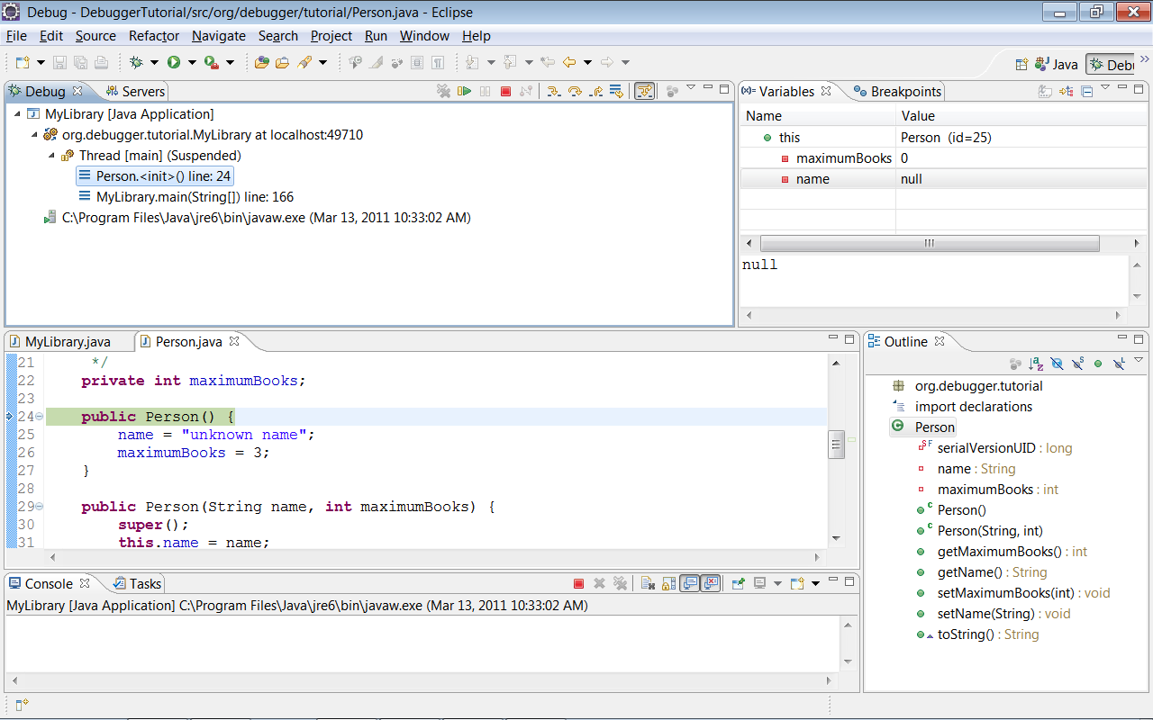
“this” variable
toString

Slide 16
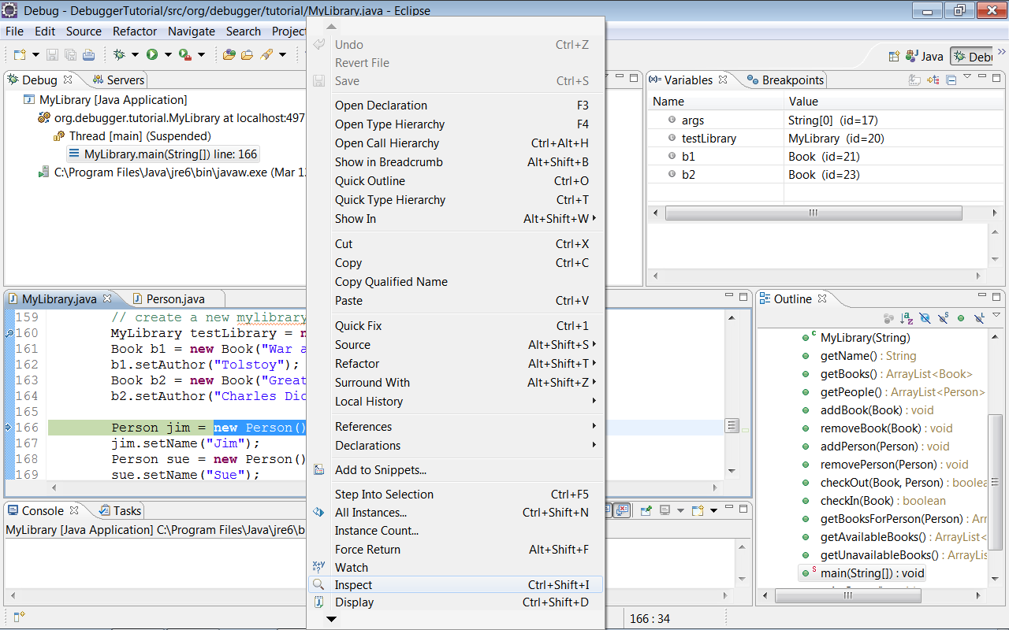
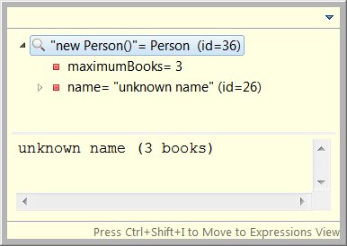
inspect

Slide 17
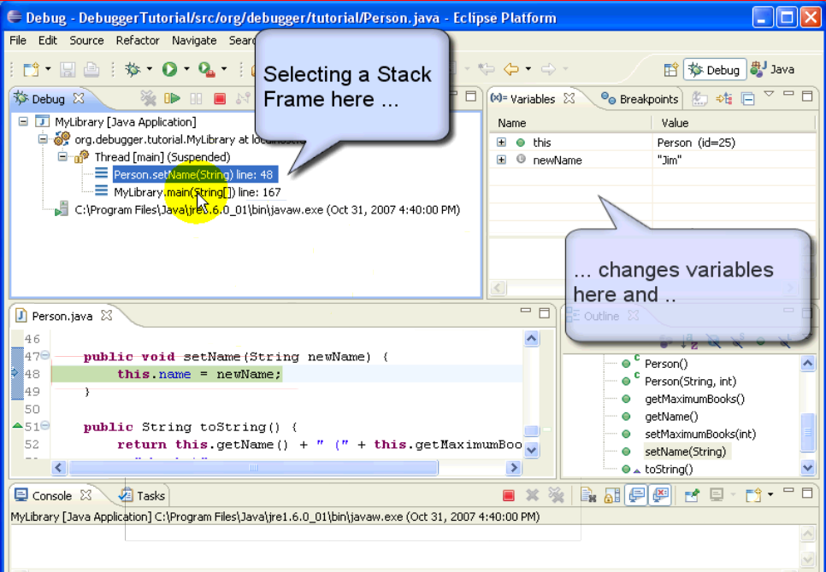
Select a stack frame

Slide 18
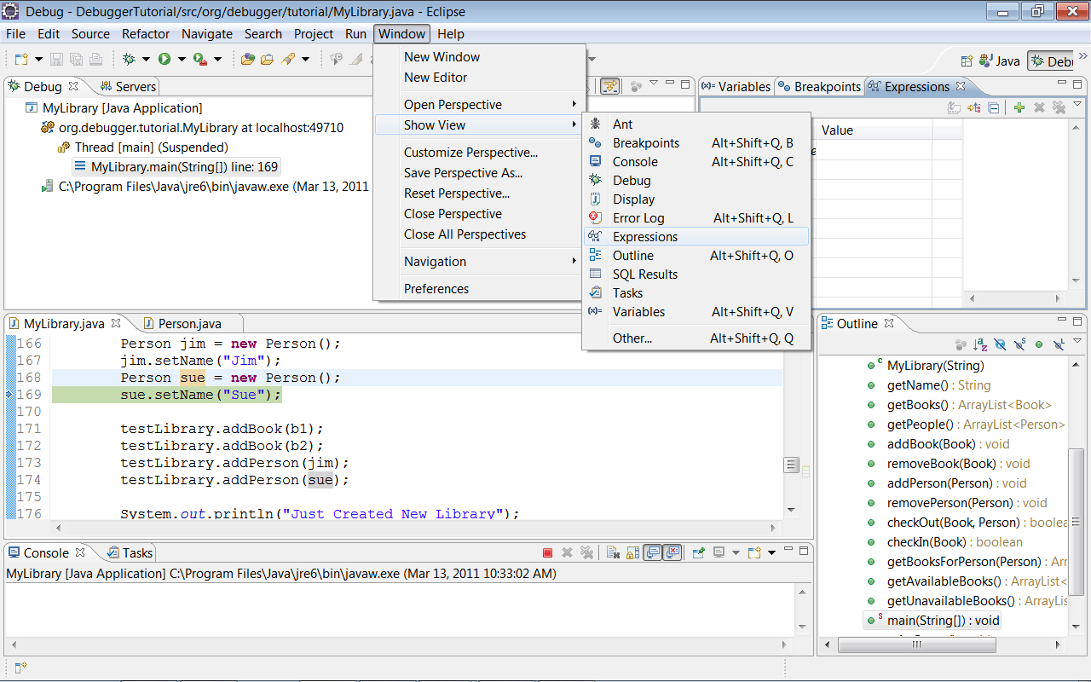
Watch Expression
Windows – Show View - Expression
Notes:
Windows – Show View – Expression (open expression window)

Slide 19
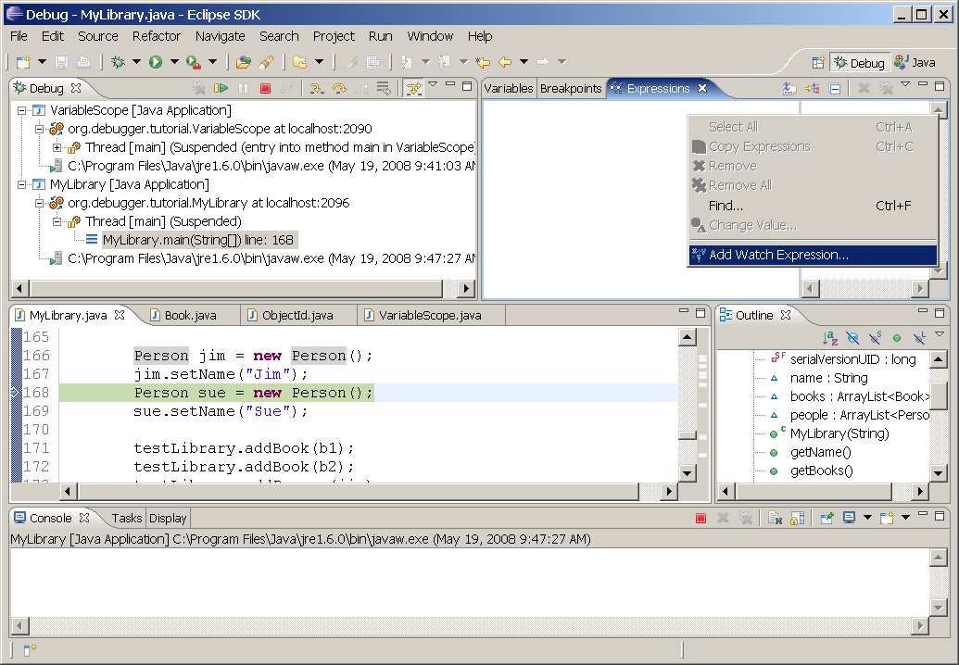
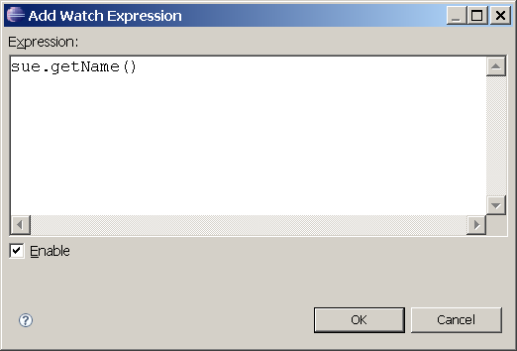
Add Watch Expression
Notes:
Right click on Expression window – select Add watch expression

Slide 20
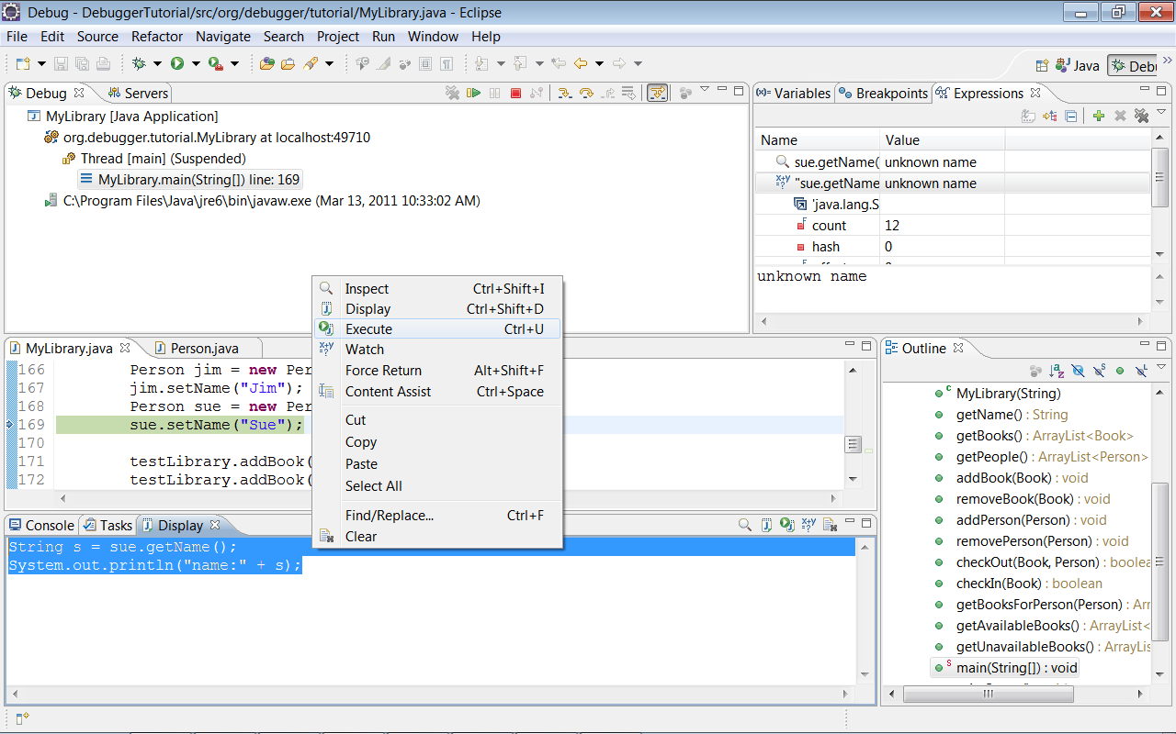
Display views
Notes:
Windows – Show view - Display

Slide 21
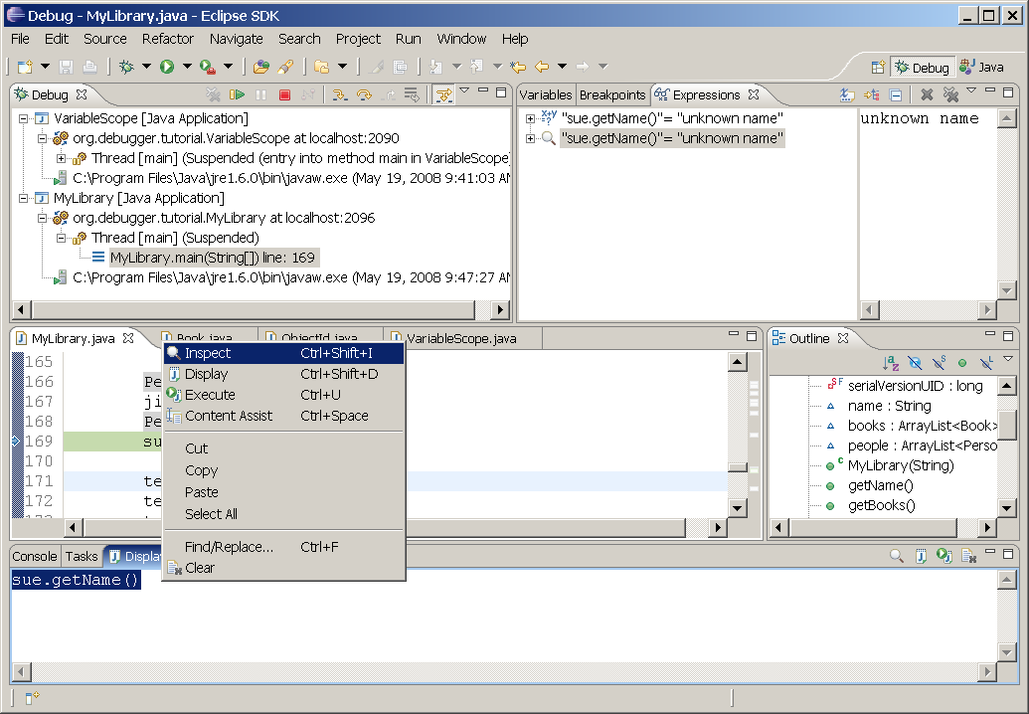
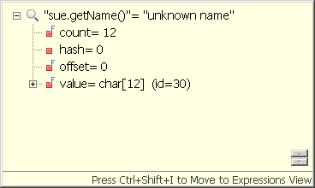
Watch and Display Views
Expression
Inspect
CTRL-SHIFT-I Move from Inspect View to Expression View
Notes:
From Inspect popup – CTRL-SHIFT-I chuyển biến đang xem sang Expression Windows
Move from Inspect View to Expression View: Ctrl+Shift + I

Slide 22
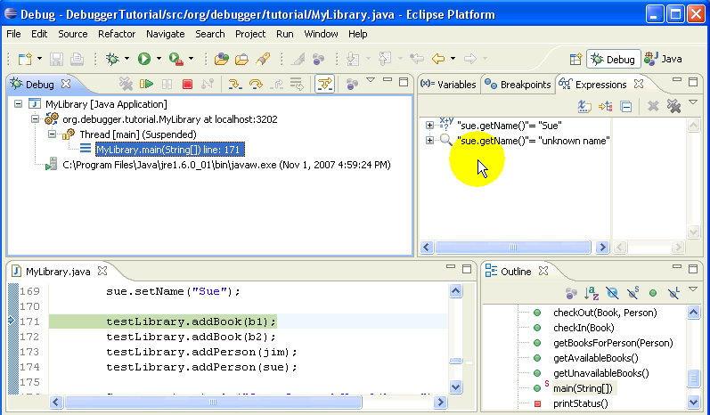
Watch and Display Views
Sự khác biệt cơ bản giữa Expression và Inspect trong cửa sổ Expression View là Inspect luôn hiển thị giá trị không đổi (giá trị tại thời điểm chuyển) còn giá trị của expression thay đổi khi tiếp tục chạy chương trình

Slide 23
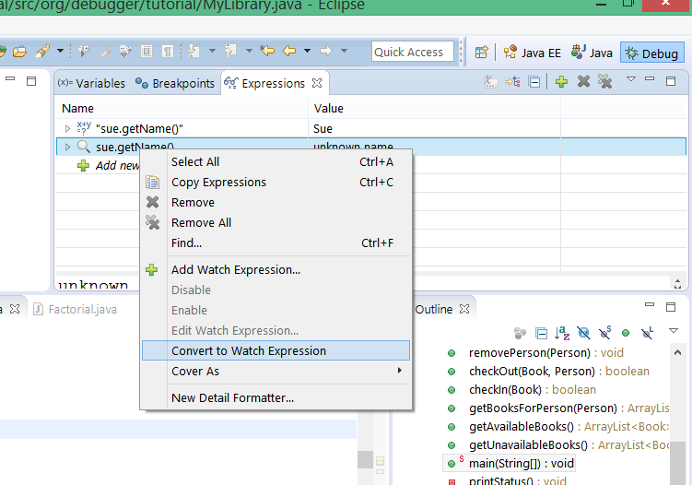
Convert Inspect Variable to Expression
Right Click
Notes:
Right Click – Select Convert to Watch Expression

Slide 24
End of first day

Slide 25
Part 3
Debugging MyLibrary class
Debug as JUnit Test (/test/MyLibraryTest.class)
Method check out
Add Java Exception BreakPoint
Executing code while debugging
Adding watch expressions
Modifying code while debugging
Select Closing Element (Expression): ALT-SHIFT-UP/DOWN
Notes:
lession04

Slide 26
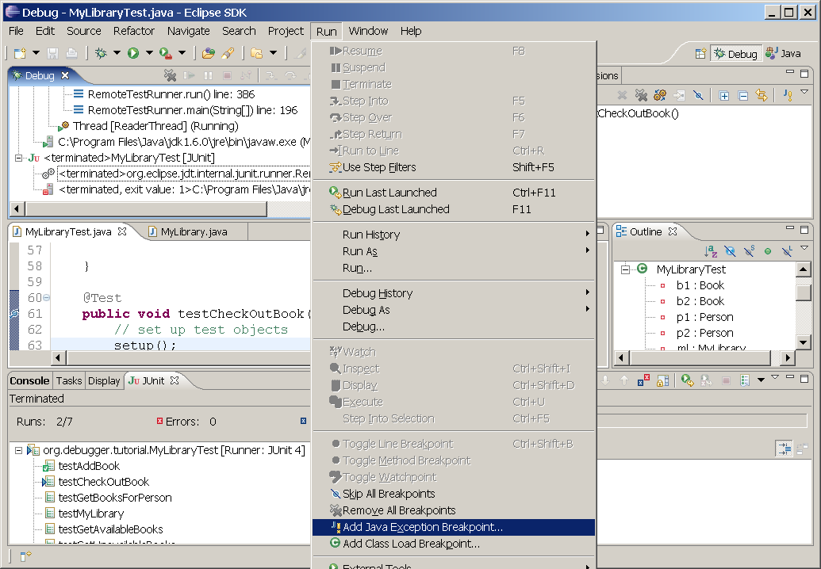
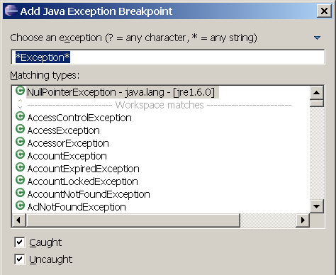
Add Java Exception BreakPoint
Notes:
Run – Add Java Exception breakpoint

Slide 27
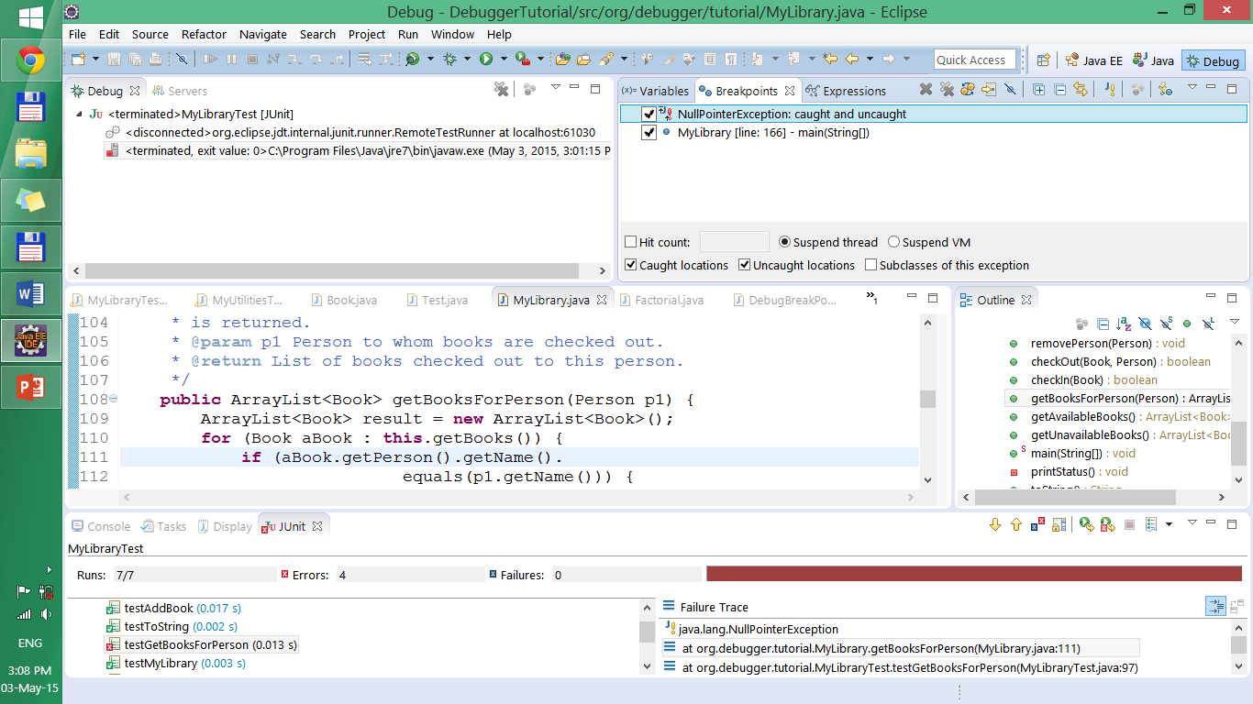
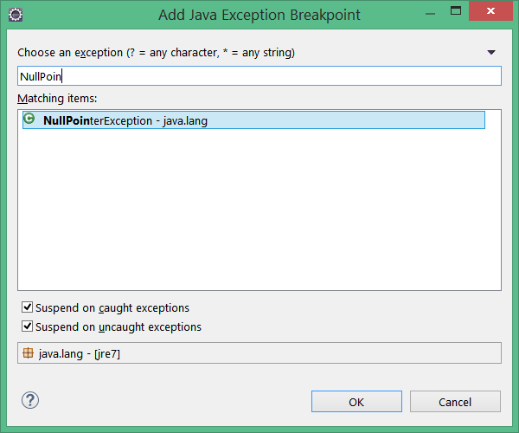
Add NullPointerException Breakpoint

Slide 28
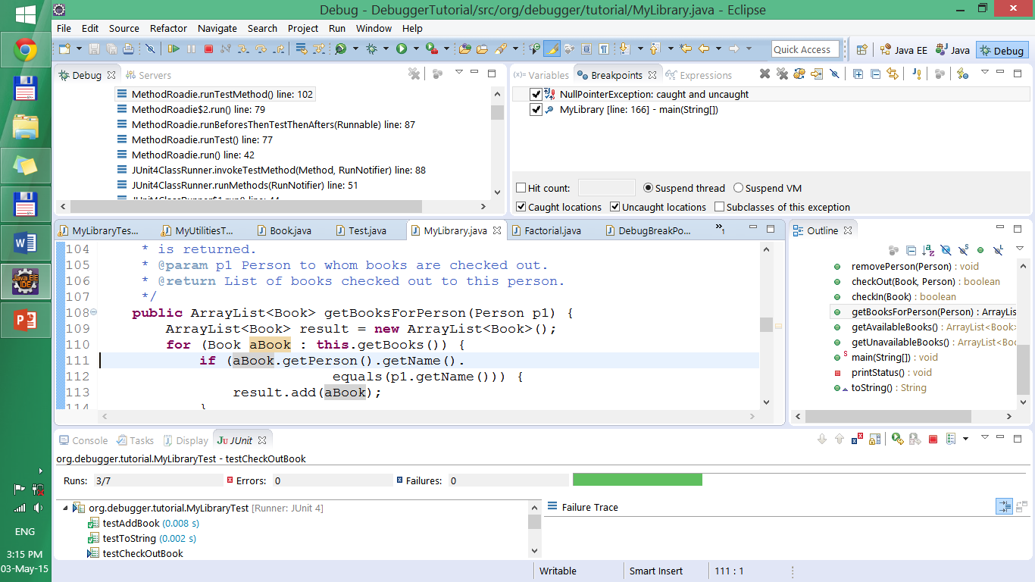
Add NullPointerException Breakpoint
No breakpoint set at line 111, but program stops because of NullpointerException

Slide 29
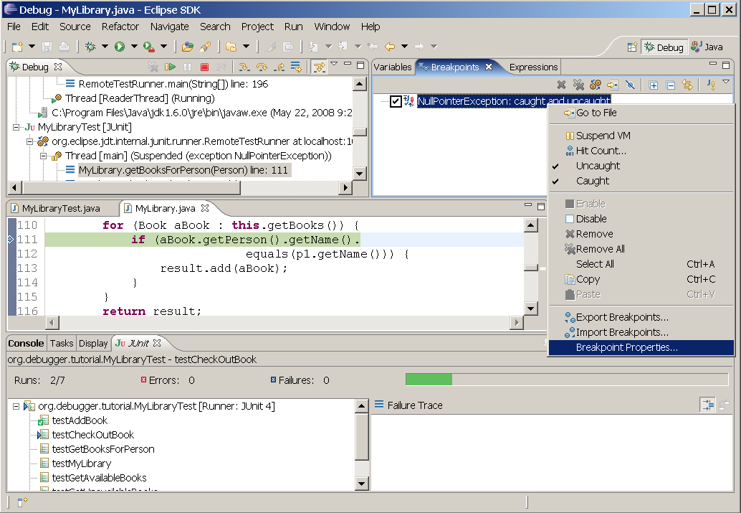
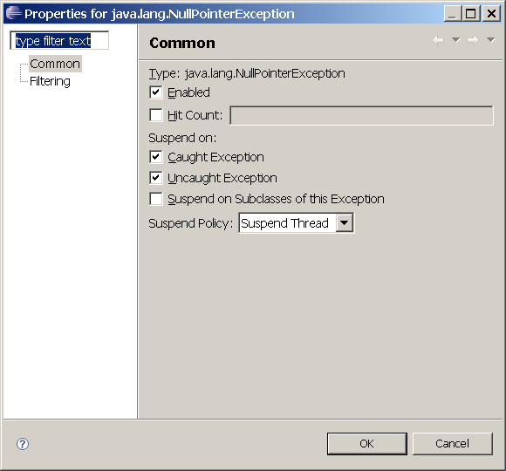
BreakPoint Properties

Slide 30
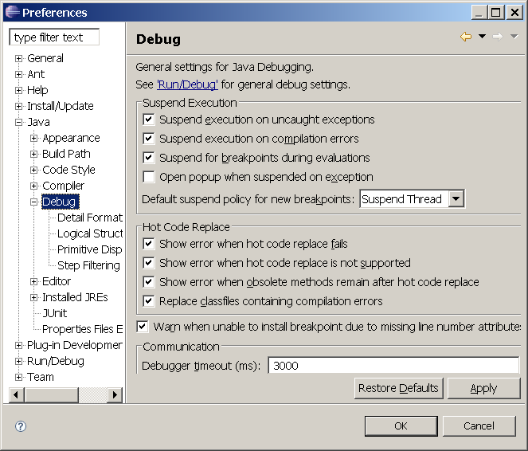
Preferences Configuration
Windows – Preferences – Debug
Auto suspend program execution on exception during debugging
Notes:
Windows – Preferences – Debug
Auto supend program execution on exception during debugging

Slide 31
Modifying code while debugging
Eclipse Debugger uses “Hot Code Replace” Allows us to change code in the middle of debug session (during debugging) an continue running program
Notes:
Khi đang debug mà sửa mã nguồn và lưu file thi debug tự động chạy lại và dừng trước dòng vừa sửa

Slide 32
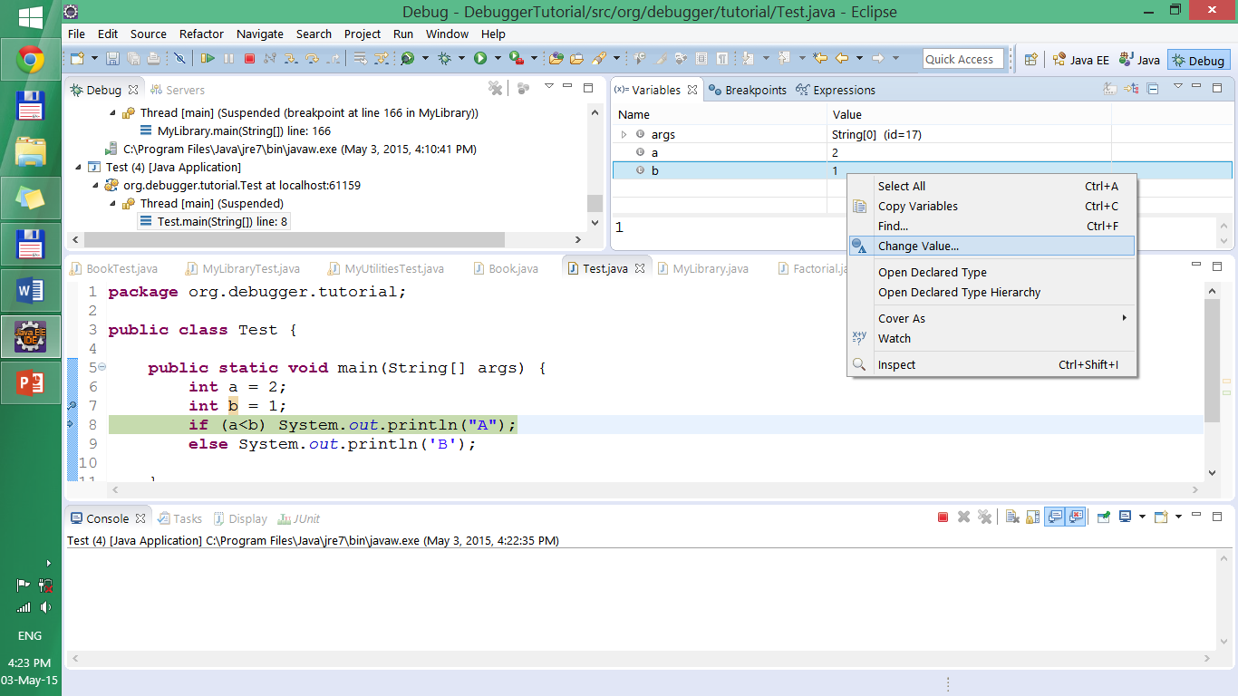
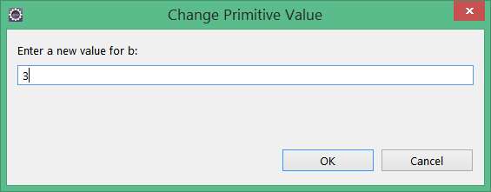
Change variable value during debuging
Notes:
Chuột phải lên biến cần thay đổi - chọn Change value - nhập giá trị mới

Slide 33
Part 4
Breakpoint option:
Hit counts and
conditional Breakpoints
Class BreakPoints and WatchPoints
Suspend command
Step into Selection
Notes:
Lession05
checkIn method

Slide 34
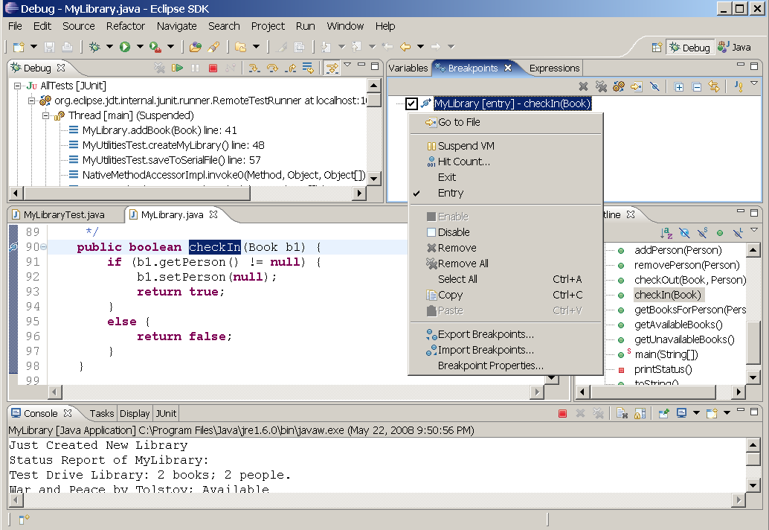
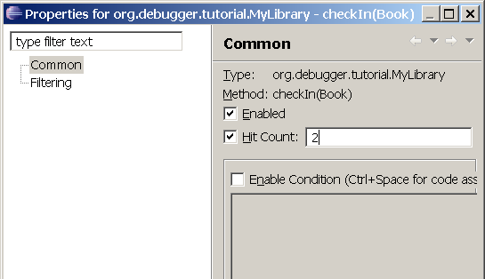
Breakpoint option: Hit counts
Don’t suspend until this breakpoint has been hit this many times
Notes:
Số lần mà breakpoint chạy qua sau đó mới debugger mới supend chương trinh tại điểm breakpoint đó

Slide 35
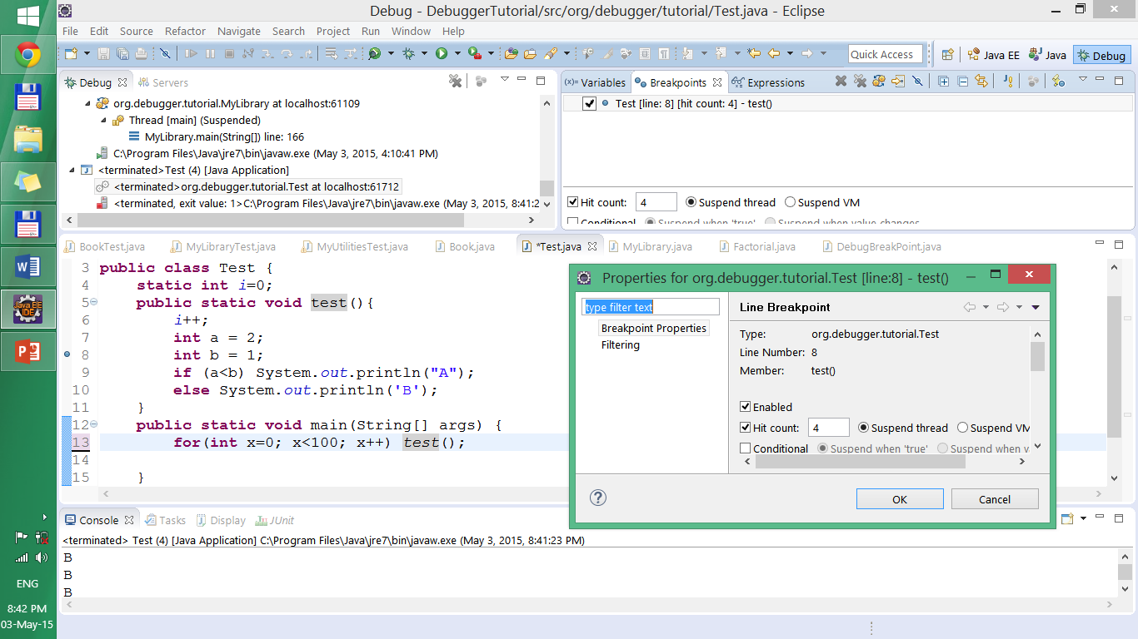
Example: Hit counts = 4
CT sẽ dừng ở dòng số 8 sau 3 lần gọi hàm test()

Slide 36
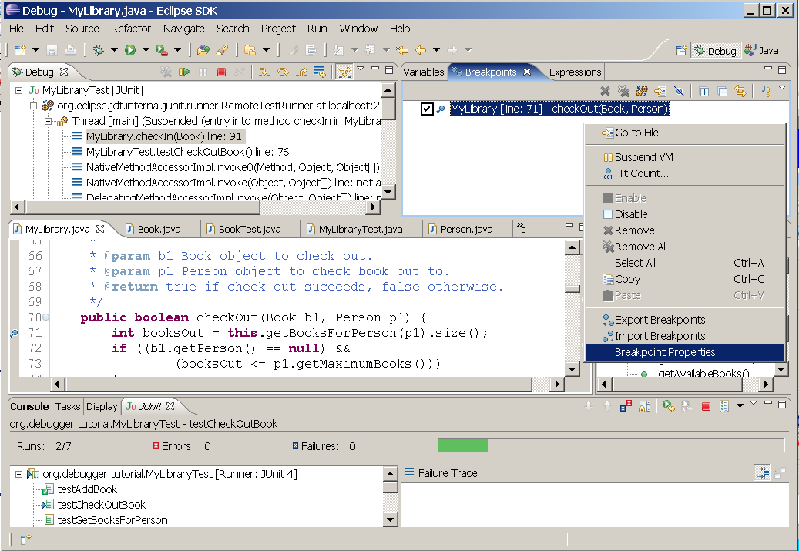
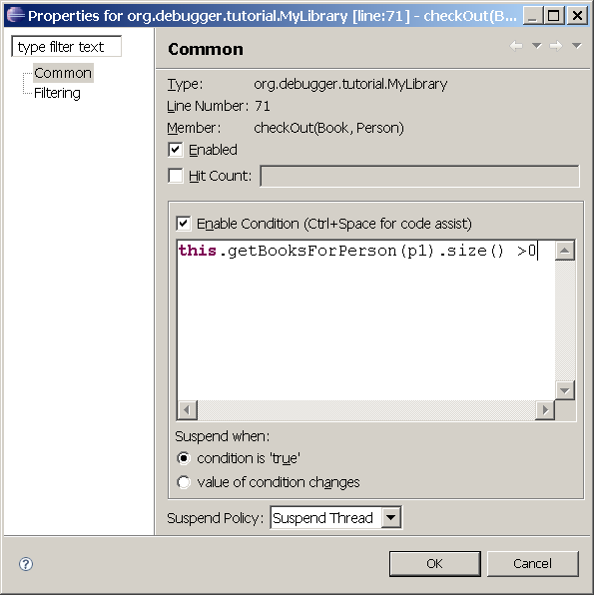
Conditional BreakPoints
Only suspend if this condition is true

Slide 37
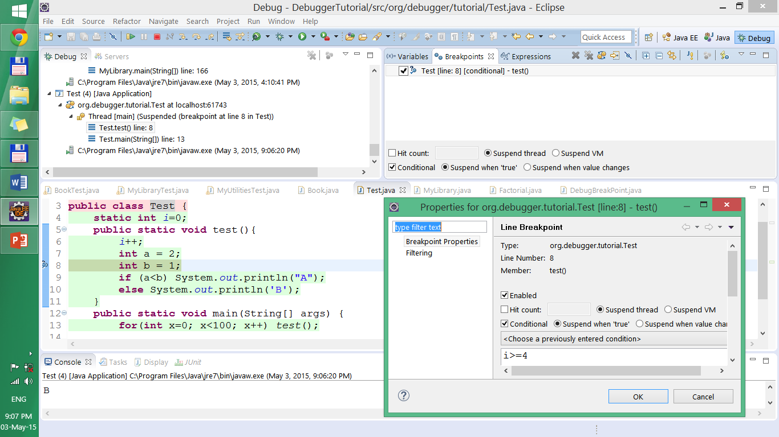
Conditional BreakPoints - Example
CT sẽ dừng ở dòng số 8 khi i == 4

Slide 38
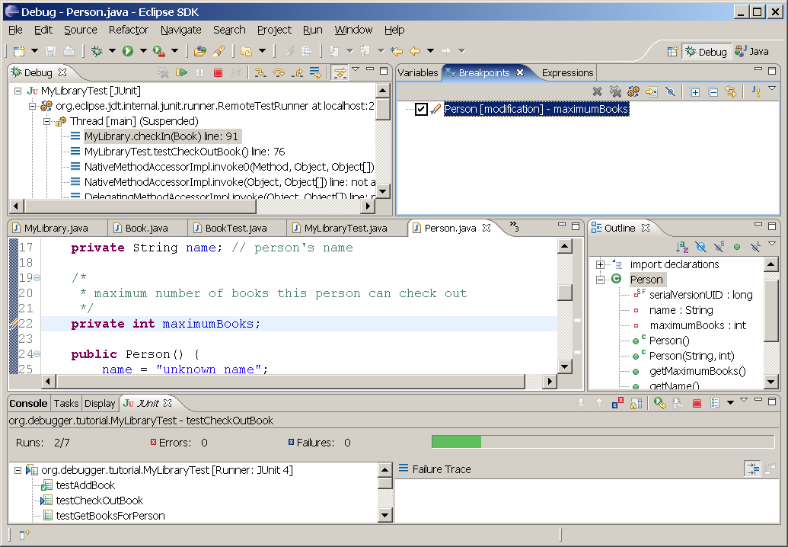
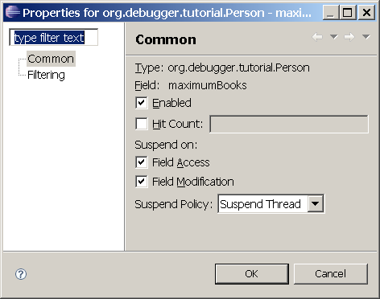
WatchPoint - Field breakpoint
Set breakpoint on member variable
Notes:
Set breakpoint trên member variable để theo dõi khi nào field bị truy xuất hoặc thay đổi giá trị. Ví dụ khi contructor gán giá trị

Slide 39
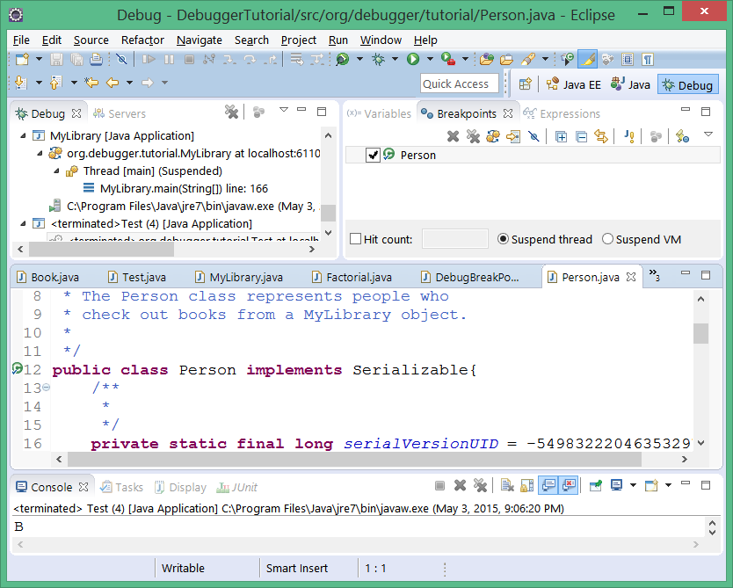
Class breakpoint
Suspends at first loading of class

Slide 40
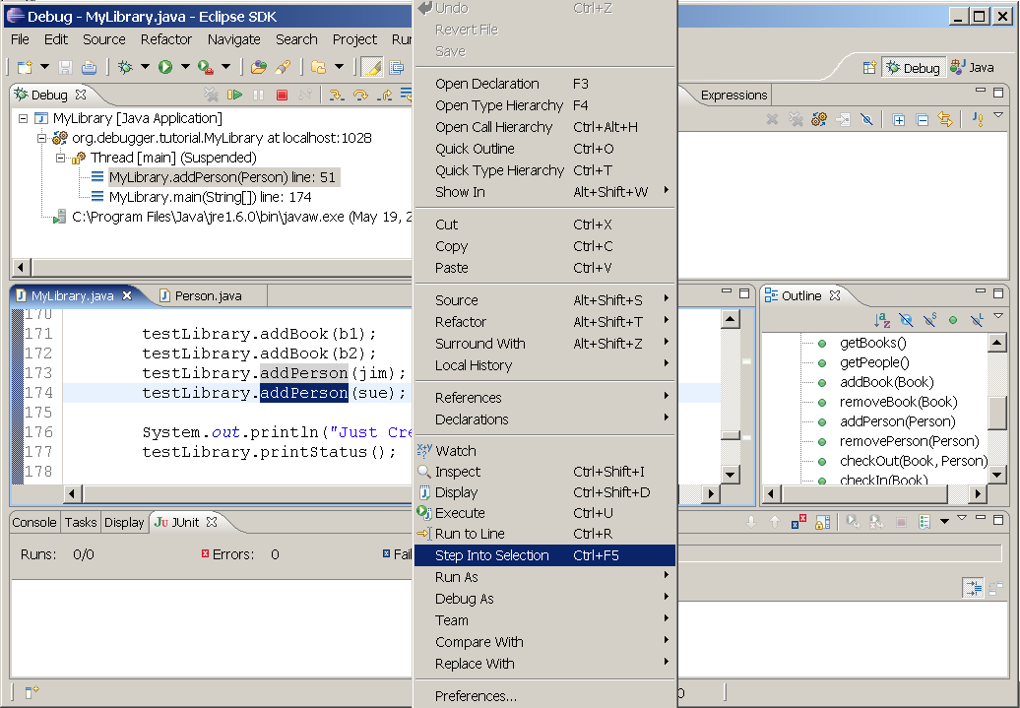
Step into Selection
Notes:
CTRL-ALT + click vào phương thức

Slide 41
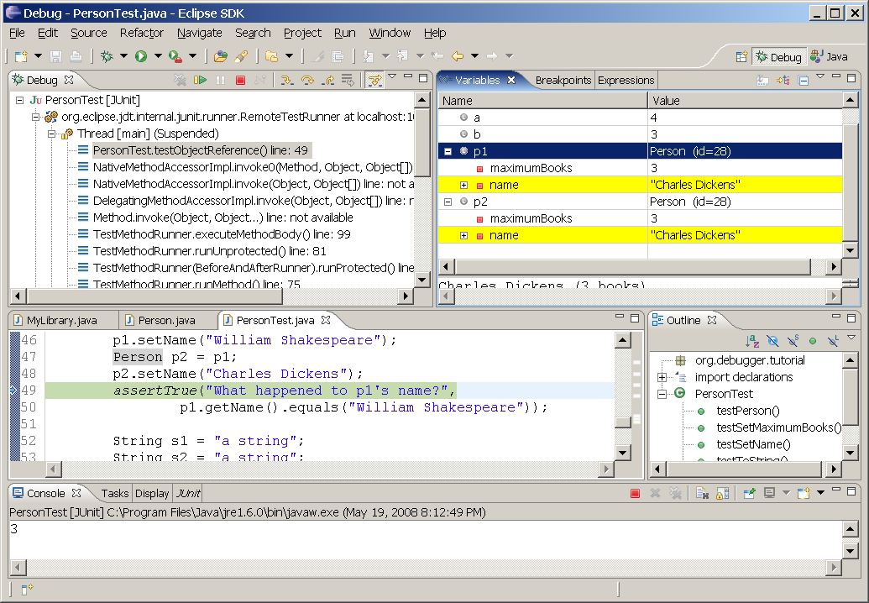
Test Object Reference

Slide 42
Debugging into Java Classes
Attaching source code allows us to browse source code but not debug into source code
To debug Java Classes, need special version of Java Runtime Engine (JRE)
This version is included with JDK 1.6 (“C:\Program Files\Java\jdk1.6.0\jre”)
Need to configure Eclipse to use this special JRE
Test method: addBook

Slide 43
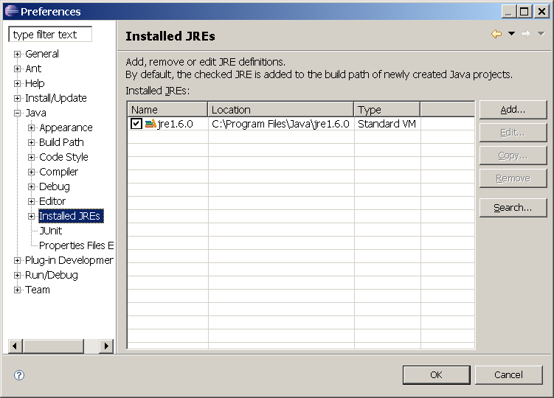
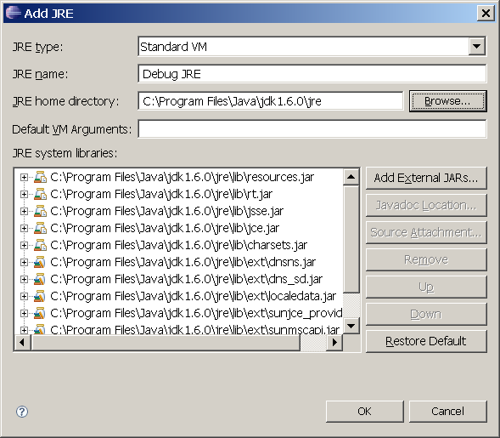
Configure Eclipse

Slide 44
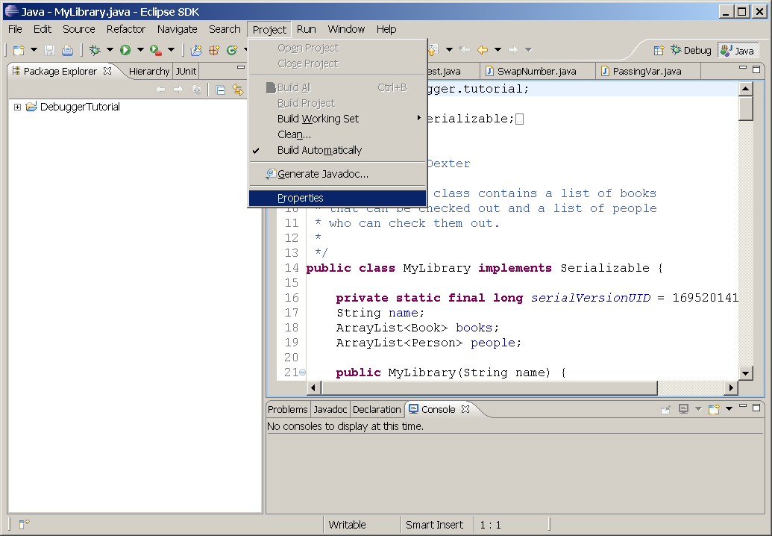
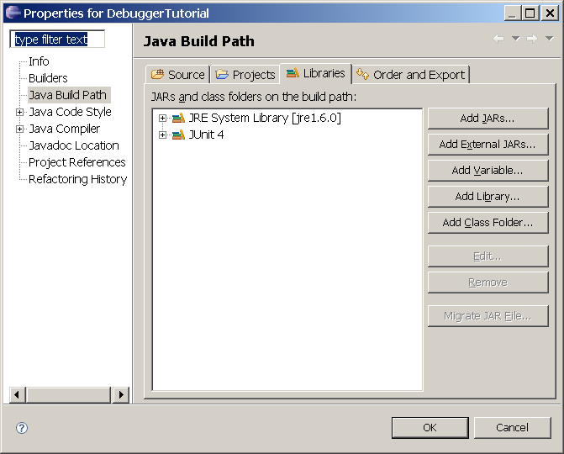
Configure Eclipse

Slide 45
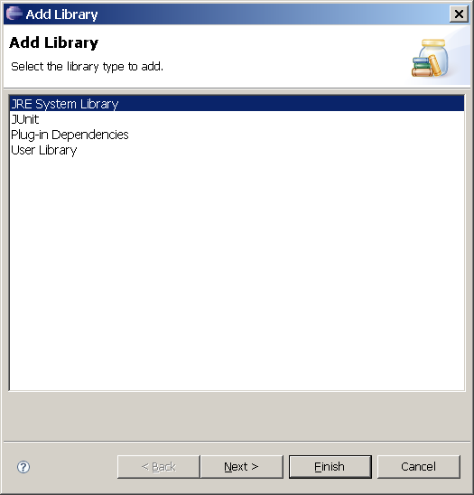
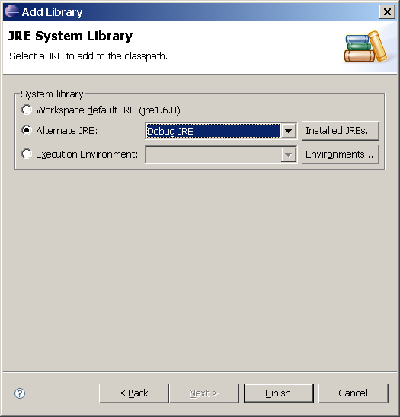
Configure Eclipse

Slide 46
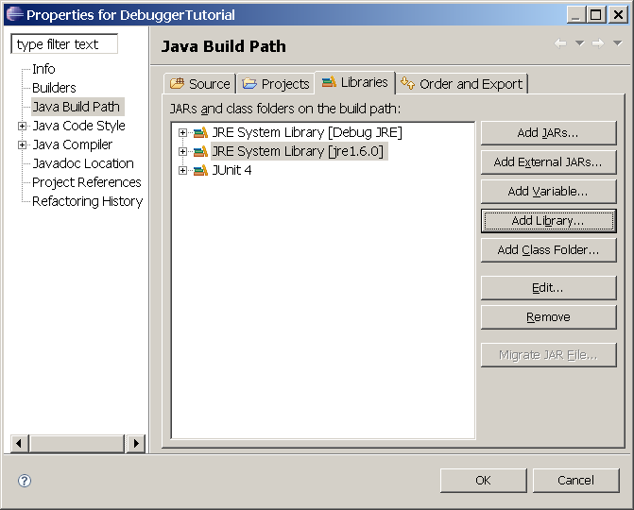
Configure Eclipse

Slide 47
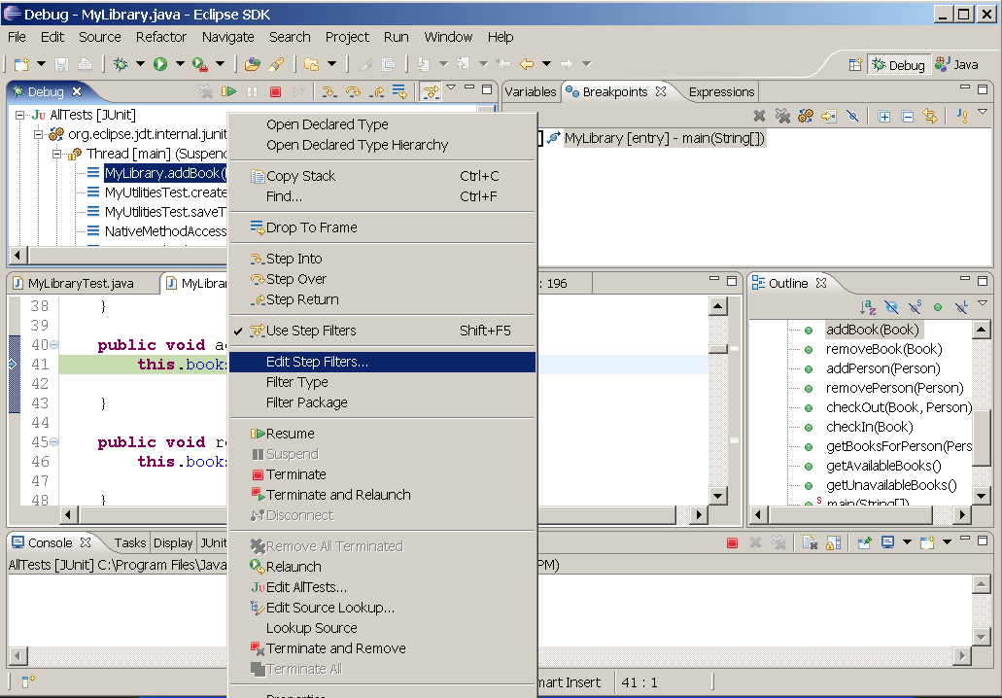

Step Filter

